Slide 1
DSD and TB/HIV services in Zimbabwe
Dr. Tsitsi Apollo, MBChB, MPH, MBA
Deputy Director HIV/AIDS and STI, MOHCC
22 July 2019

Slide 2
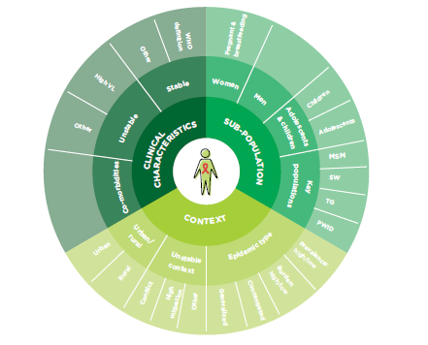
Presentation Outline
Background
Progress in Implementing TPT
DSD for TB/HIV Opportunities and Challenges
Conclusions

Slide 3
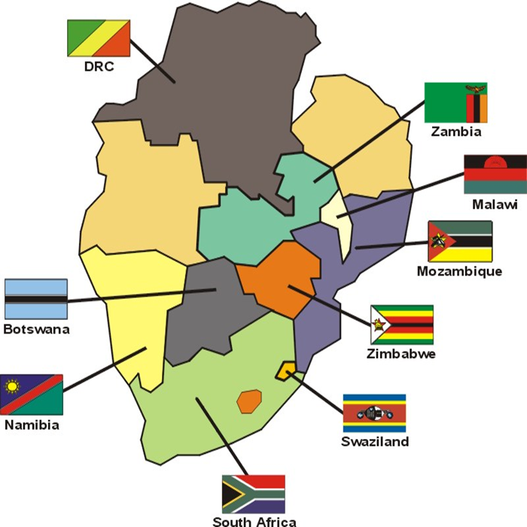
Background
Zimbabwe remains one of top 8 countries in Africa on world’s top 30 list of countries heavily burdened by TB, TB/HIV and MDR-TB
HIV prevalence of 14,6% (ZIMPHIA, 2016)
TB prevalence of 221 /100,000 population
TB/HIV co- infection rate of 63% (Global TB Report, 2018)
4.6% and 14.2% Rifampicin Resistant-TB among new and re-treatment cases respectively (Zimbabwe National TB Drug Resistance Survey, 2016)
Zimbabwe Population: 13 M

Slide 4
TB/HIV Country Context
Country adapted 2004 WHO interim policy on collaborative TB/HIV activities
Strengthening collaborative mechanisms between national TB and AIDS programmes
Reduction of TB burden among PLHIV
(3 I’s)
Reduction of HIV burden among TB patients

Slide 5
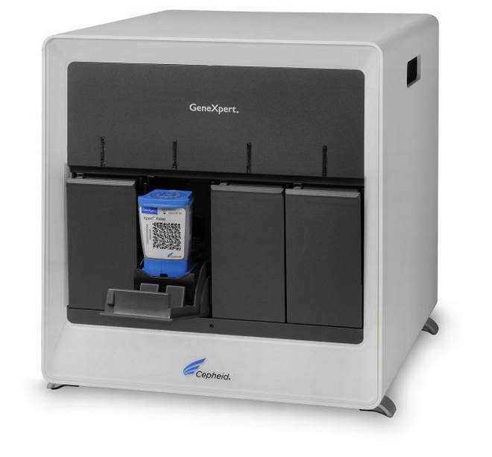
Reducing the Burden of TB among PLHIV (3 I’s)
Intensified TB Case Finding:
Four symptom based screening tool (current cough, fever, weight loss & night sweats) adopted and currently being used to screen all clients for TB
Microscopy centres established and microscopists engaged in all districts to support early TB diagnosis
A total of 136 plus GeneXpert instruments have been deployed across all districts
A sample transportation system was put in place to complement TB diagnosis

Slide 6
Roadmap in Implementation of the National ICF/IPT Programme
Adaptation processes of the 2011 WHO ICF/IPT Guidelines
Feasibility Phase of ICF/IPT implementation
Stakeholder Sensitization meetings at various levels on ICF/IPT
Capacity & Skills Building
of HCWs to provide ICF/IPT services.
Revision of M&E Data Reporting and Recording Tools
Post Feasibility Phase of ICF/IPT Implementation
Jan 2012 – Dec 2013
(10 sites)
Jan 2014 – Dec 2018
( 1280 sites)
Indicator | 2018 | 2019 | 2020
% of adults and children in HIV care started on TB preventive Therapy | 15% | 25% | 40%
Notes:
Prior to Dec 2012 ,only limited to children under 5 years of age who are household contacts of smear-positive TB patients
Following adaptation of the 2011 WHO guidelines on ICF/IPT in 2012 , the MOHCC commissioned a feasibility phase in ICF/IPT implementation in 10 selected sites across 5 provinces (Harare, Bulawayo; Mat North, Mat South and Midlands)

Slide 7
Setting: 7 pilot sites in Zimbabwe implementing 6 months of isoniazid preventive therapy (IPT) for PLHIV
Objectives: To determine, among PLHIV started on IPT, the completion rates for a 6-month course of IPT and factors associated with non-adherence.
Design: A retrospective cohort study.
Results: Of 578 patients, 81% completed IPT. Of the 112 patients who failed to complete IPT, 60% were lost to follow-up, 30 (27%) stopped treatment, 8 (7%) developed toxicity/adverse reactions, 5 (5%) were documented as having drug stock-outs.
Receiving over 2 month supply of isoniazid at the start of treatment was associated with a lower risk of not completing IPT, while missing clinic visits prior to starting IPT was associated with a higher risk of non-completion.
Notes:
Conclusion: IPT completion rates in seven pilot sites of Zimbabwe were comparatively high, showing that IPT roll-out in public health facilities is feasible. Enhanced adherence counselling or active tracing among pre-ART patients and those with a history of loss to follow-up may improve IPT completion rates, along with synchronising IPT and ART resupplies.

Slide 8
Zimbabwe National Progress in TPT Implementation, 2012-2018
Intervention:
Strengthened counselling of clients on IPT
Synchronized ARV and INH pick up visits
Spaced meds pick up visits to 3 monthly
Changed the INH formulation from 100mg to 300mg tabs to reduce pill burden
No. of ART sites
offering IPT increased from 10/1560 (<1%) in 2012 to 1,280/1,560 (82%) by 2018
Cumulative no. of ART clients
started on IPT increased from
98 in 2012
to 373,819 by 2018

Slide 9
Development of TB and toxicities/side-effects among TPT clients in Zimbabwe, 2012 – 2018
% of clients stopping IPT due to toxicities has declined from a 1.5% peak in 2015 to 0.9% in 2018
% of IPT clients developing TB has declined over time and generally <1%

Slide 10
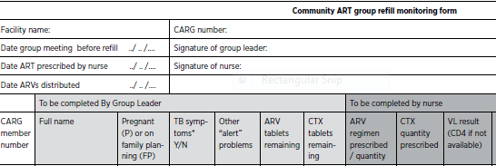
DSD for TB/HIV Opportunities:
Patients considered “stable” for DSD models are also eligible for TPT
Peer support and community monitoring systems for ART can be extended to TPT
Leveraging on existing robust medicines supply chain for ARVs to support TPT drugs
Drug pick up visits for ARVs and TPT have already been synchronized with multi-months scripting
Screening for TB during CARG meetings
Possibility of TB sputum negative patients to be included in community- based DSD models
Potential to utilize existing DSD models to train clients to report adverse events to regulatory authority via e-platforms
CARG Group leader screens group members for TB symptoms and fills monitoring form

Slide 11
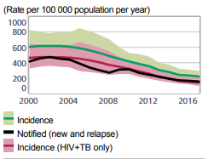
DSD for TB/HIV Challenges:
Zimbabwe TB cases notified below the estimated TB incidence
Missed TB cases
TB Treatment coverage was 71% in 2017
High burden of MDR-TB
“Double” stigma associated with TB and HIV diseases
Pill burden needs to be managed
Consider use of INH/B6/CTX as an FDC; better formulations needed for 3HP
The National TB Program is not quite yet familiar with “DSD” concepts
Data: www.who.int/tb/data

Slide 12
Conclusion:
DSD models for TB/HIV are needed especially in high burden TB/HIV countries to address the needs of PLHIV and at high risk of developing TB
Opportunities and challenges exist in developing effective models that provide client-centred services that meet the expectations and preferences of clients without compromising their treatment outcomes
Investments in operations research are needed to further understand what would be required to inform policy and practice

Slide 13
Acknowledgements:
HIV and TB Department, Zimbabwe, MOHCC
Dr Regis Choto, Dr Kudakwashe Takarinda
HIV and TB Technical and Funding Partners

